Slide 1


Titolo presentazione sottotitolo
DAAP – Homework 2
Milano, XX mese 20XX
Space-Time based Source Separation

Slide 2
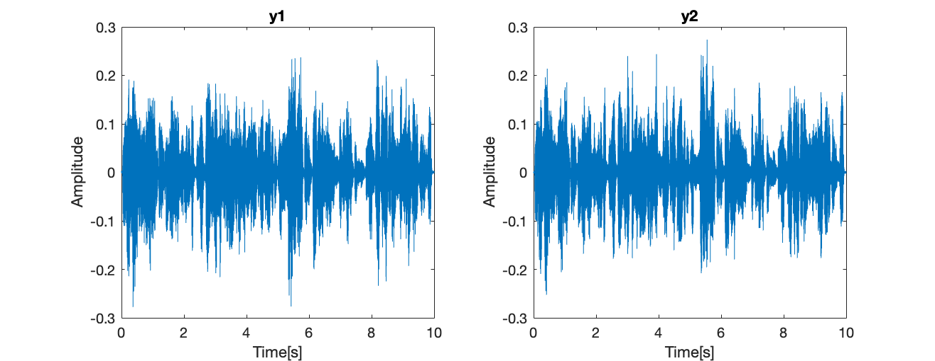
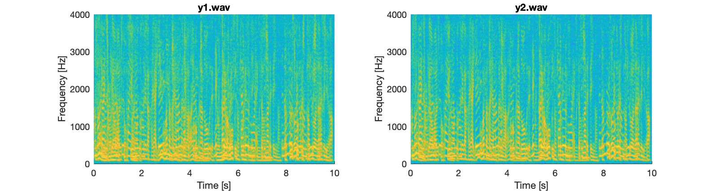
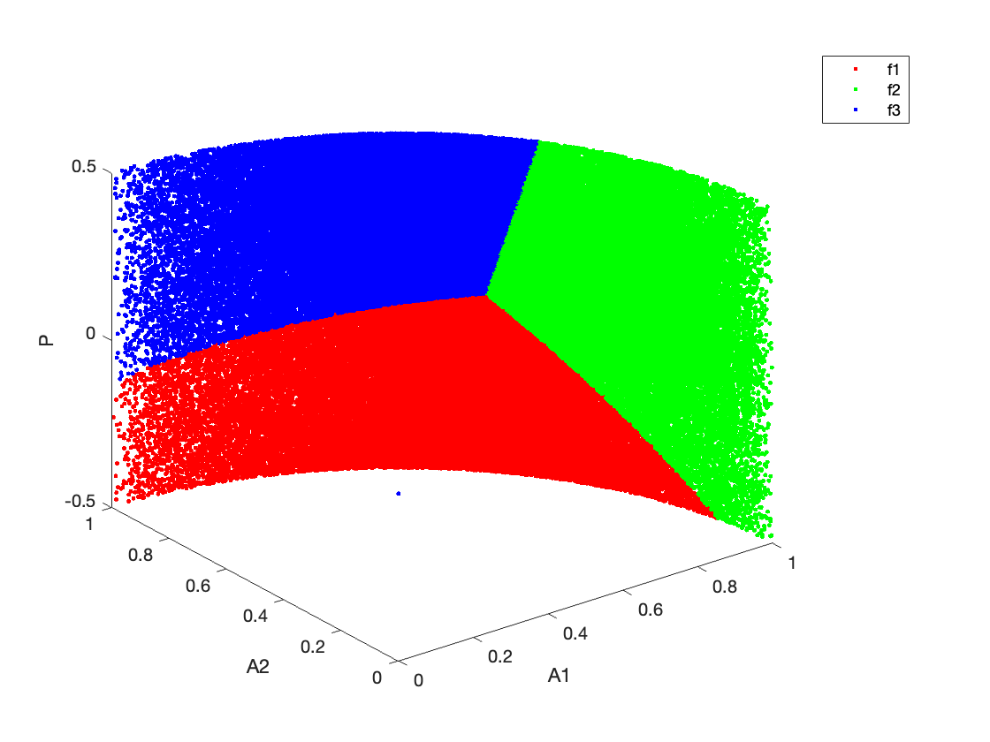
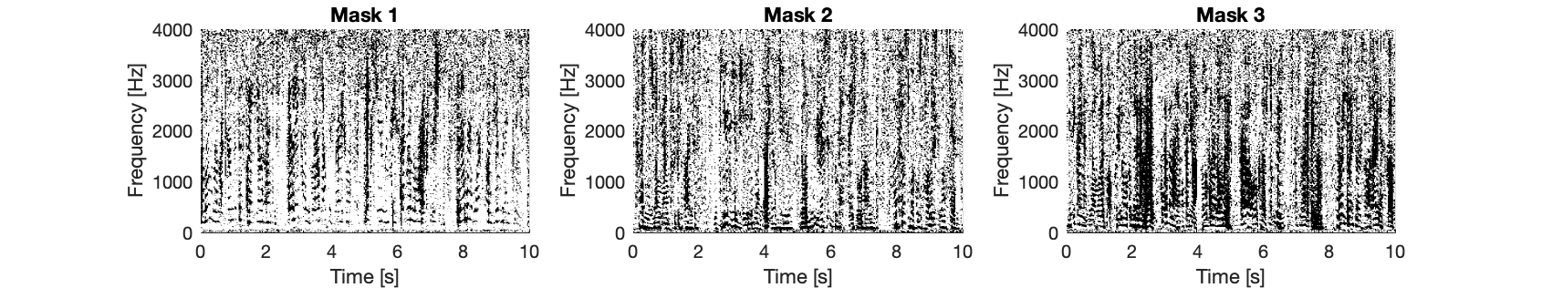


Introduction
Source Signals
Feature Extraction
via STFT analysis
Clustering via K-Means
algorythm
Binary Masking and
ISTFT

Slide 3
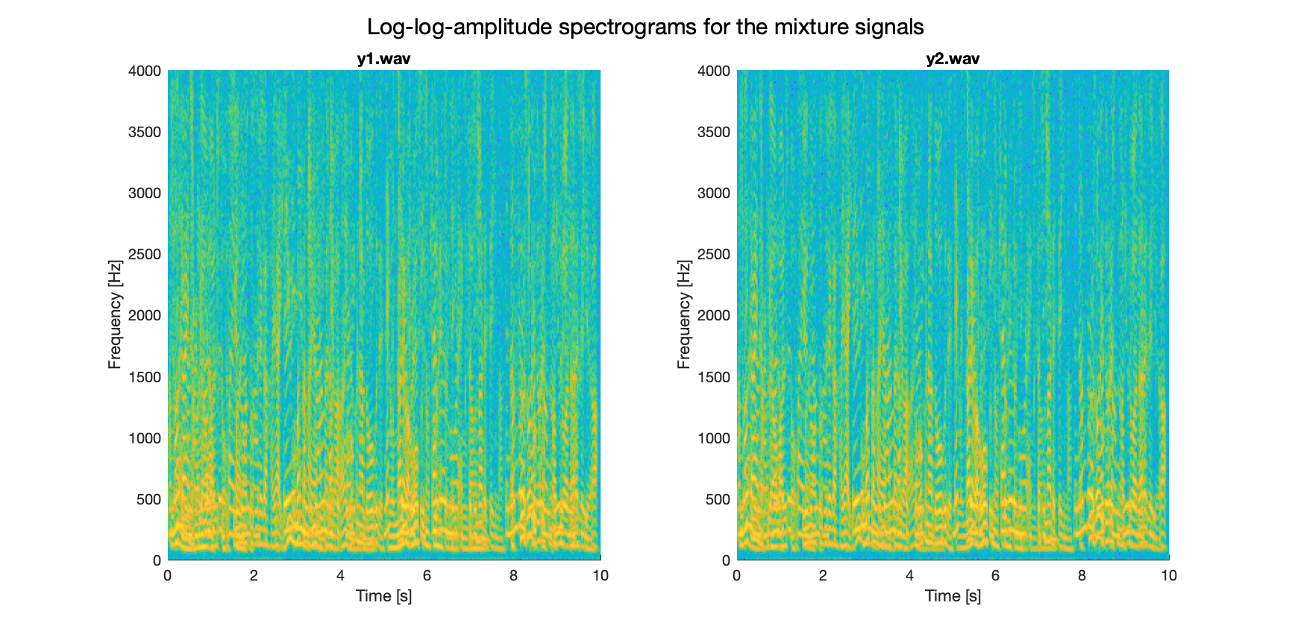
Code Rundown - STFT
STFT with COLA conditions (Hanning window, 50% overlap) Window Length: 512 samples Hop Size: 256 samples Each segment is padded to a length of 1024

Slide 4
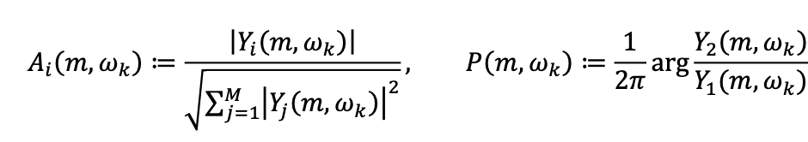

Code Rundown – Feature Extraction and K-Means Clustering

Slide 5
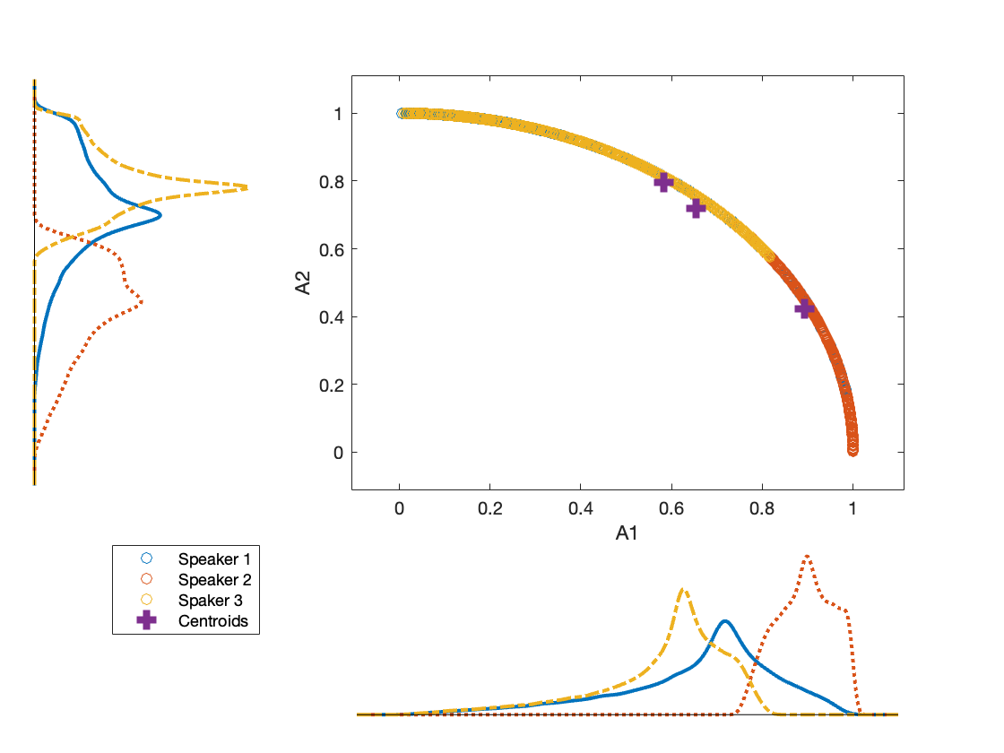
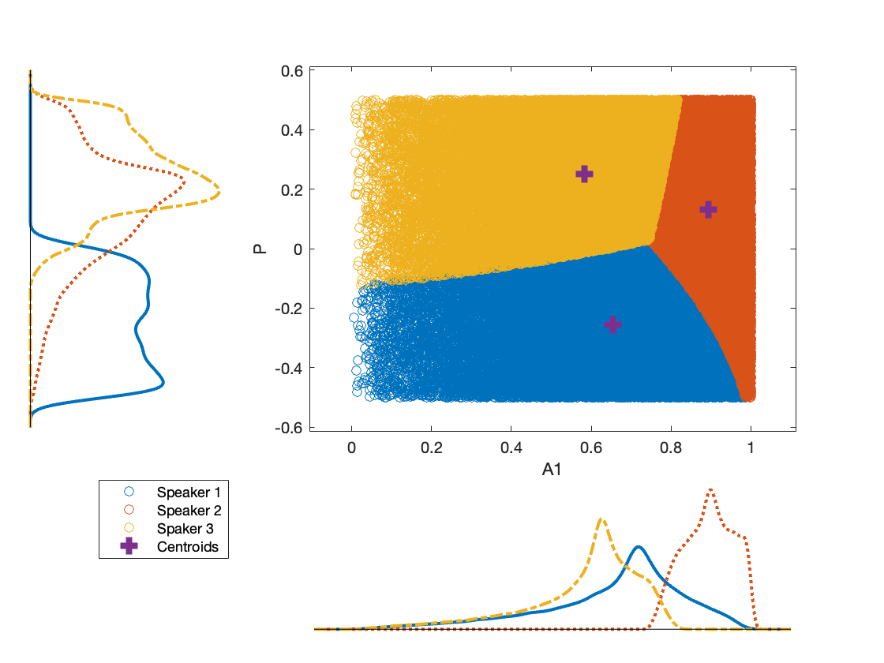
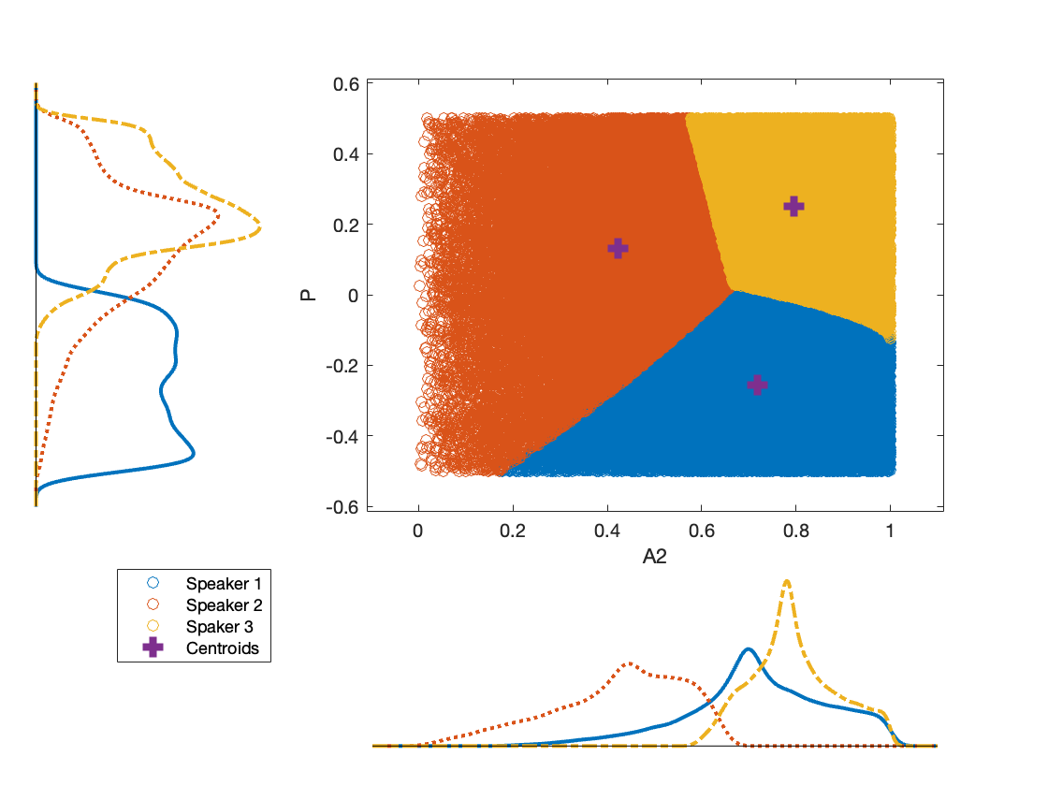
Code Rundown – Feature Extraction and K-Means Clustering
P – A2
A1 – A2
P – A1

Slide 6
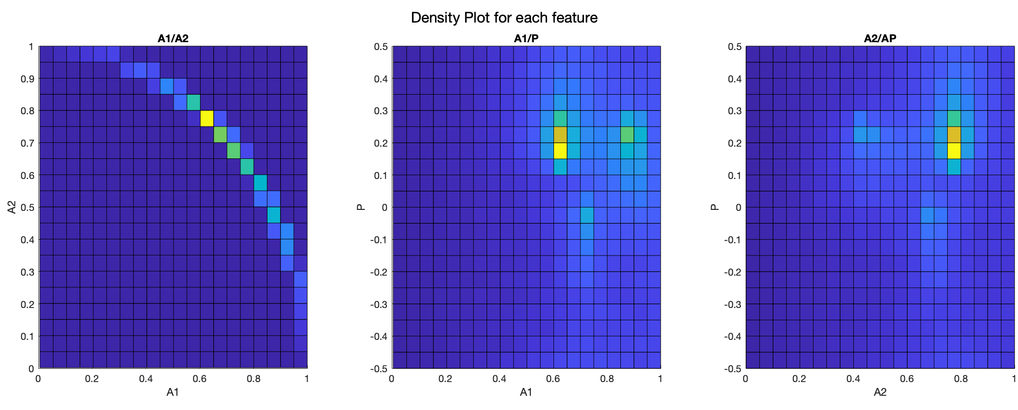
Code Rundown – Feature Extraction and K-Means Clustering

Slide 7
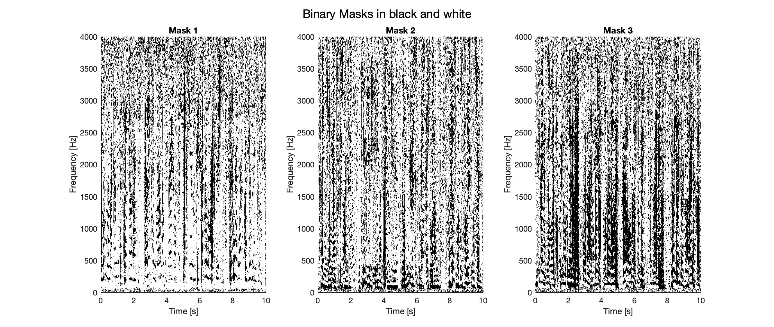
Code Rundown – Binary Masks Creation
After the K-Means clustering we can create a mask for each cluster starting from the labels of each time-frequency point then apply those masks to the STFT of y1

Slide 8
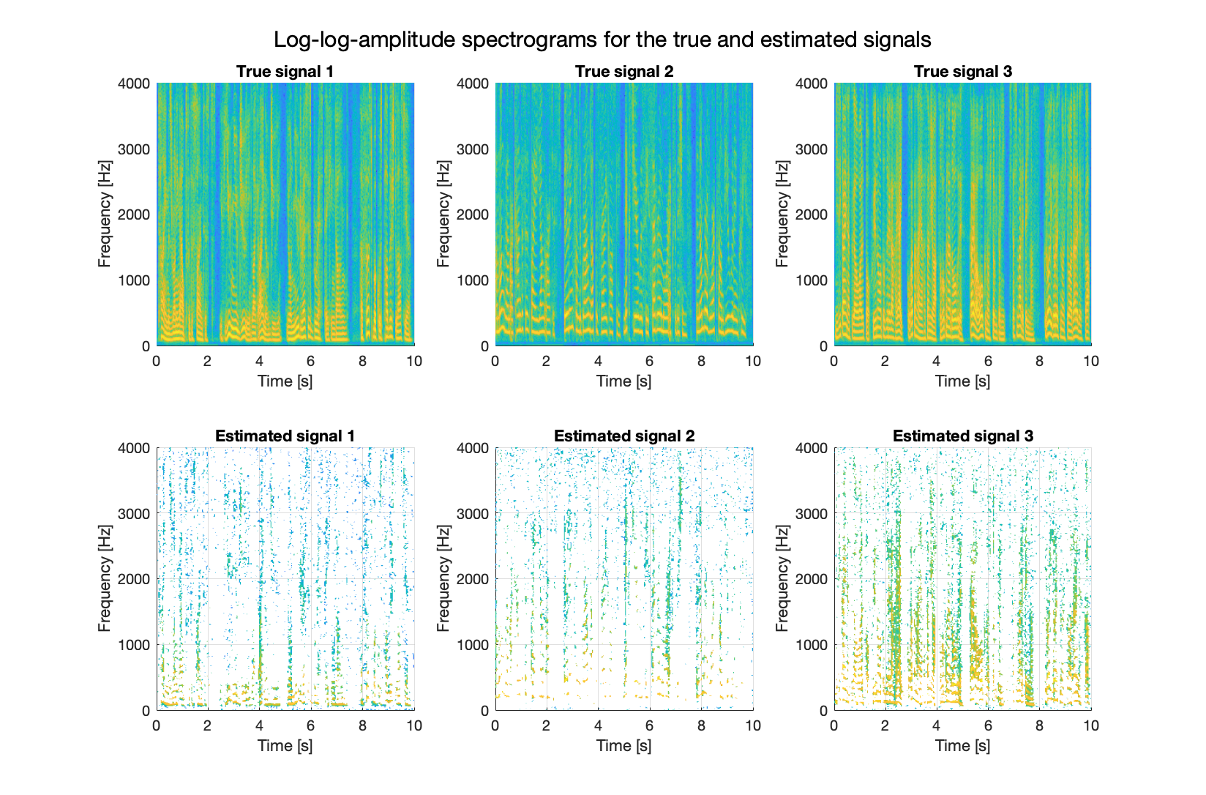
Code Rundown – Binary Masks Application
From this we obtain the following STFT spectra with comparison with the original ones
An ISTFT will give
us the reconstructed
signals from these
spectra

Slide 9
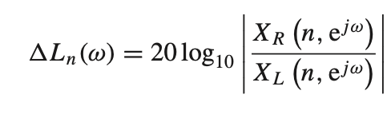
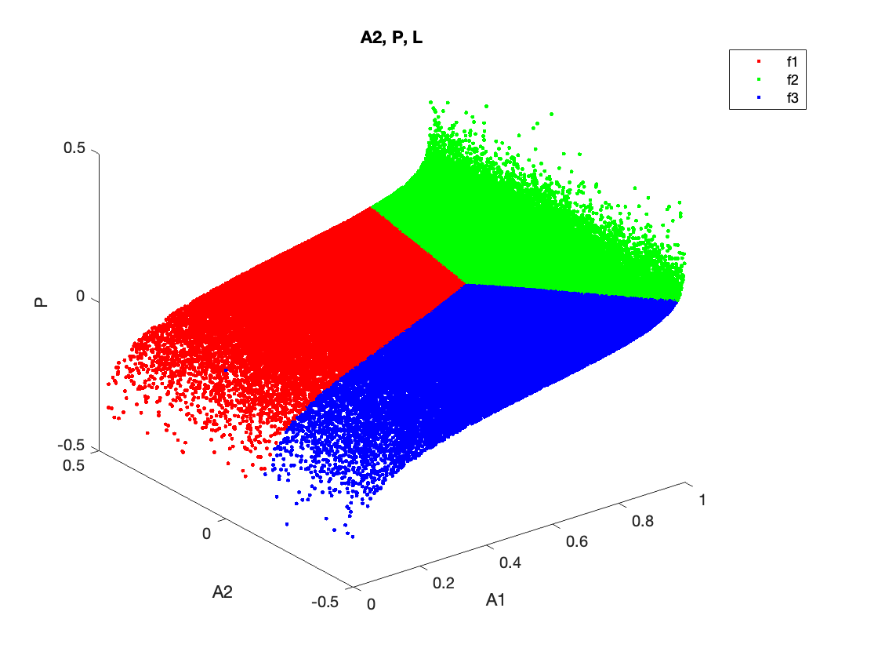
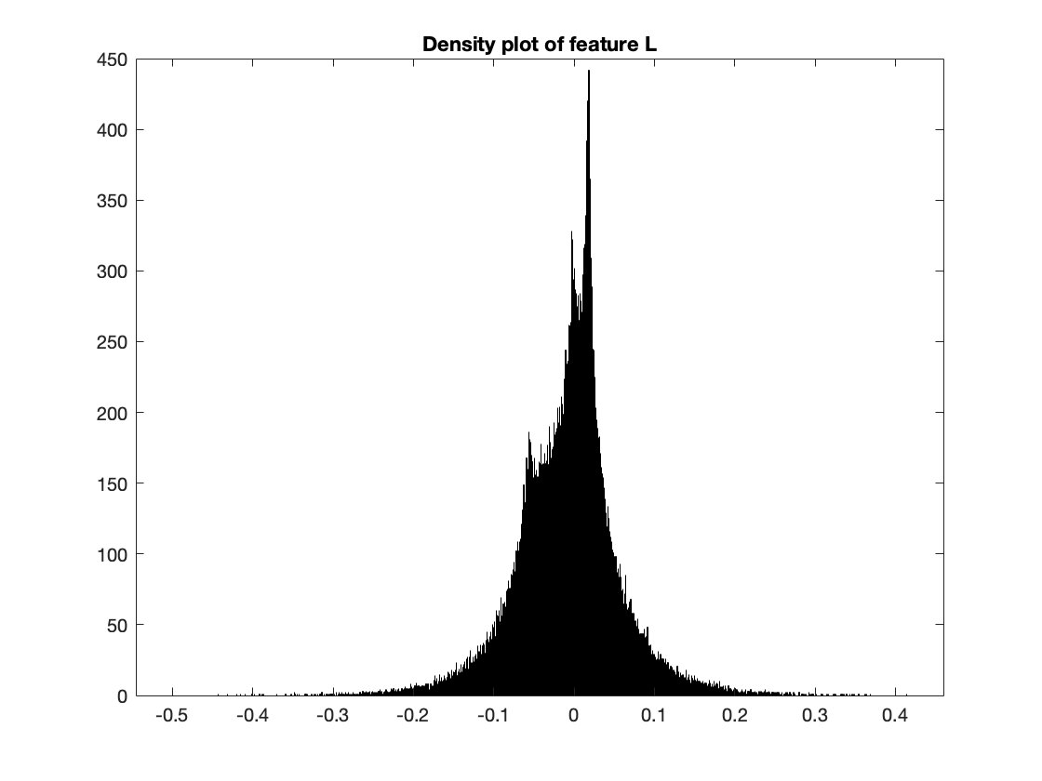
Code Rundown – Additional Feature
From DAFX, Binaural Source Separation (14.16)

